Slide 1
ToR 5:Mackerel
Alex Hansell and Kiersten Curti

Slide 2
The plan
ASAP → WHAM
Age-comps
Recruitment
Time varying
Selectivity
NAA
q

Slide 3
Age composition comparison
age_comp | converged | hessian | NLL | rho_R | rho_SSB | rho_Fbar
multinomial | Yes | No | 2305.805 | 0.1608 | 0.3633 | -0.228
dir-mult | Yes | Yes | 1769.636 | 0.5752 | 0.8363 | -0.4225
dirichlet-miss0 | Yes | Yes | -1488.64 | 0.9747 | 1.1804 | -0.4947
dirichlet-pool0 | Yes | Yes | -1481.17 | 0.9476 | 1.1474 | -0.4894
logistic-normal-miss0 | Yes | Yes | -1344.85 | 0.7369 | 0.7068 | -0.2969
logistic-normal-ar1-miss0 | Yes | Yes | -1578.05 | 0.8776 | 0.8802 | -0.4192
logistic-normal-pool0 | Yes | Yes | -1319.17 | 0.6501 | 0.6585 | -0.2722
logistic-normal-01-infl | Yes | Yes | -1319.17 | 0.6501 | 0.6585 | -0.2722
logistic-normal-01-infl-2par | Yes | Yes | -1319.17 | 0.6501 | 0.6585 | -0.2722
mvtweedie | Yes | Yes | -1319.17 | 0.6501 | 0.6585 | -0.2722

Slide 4
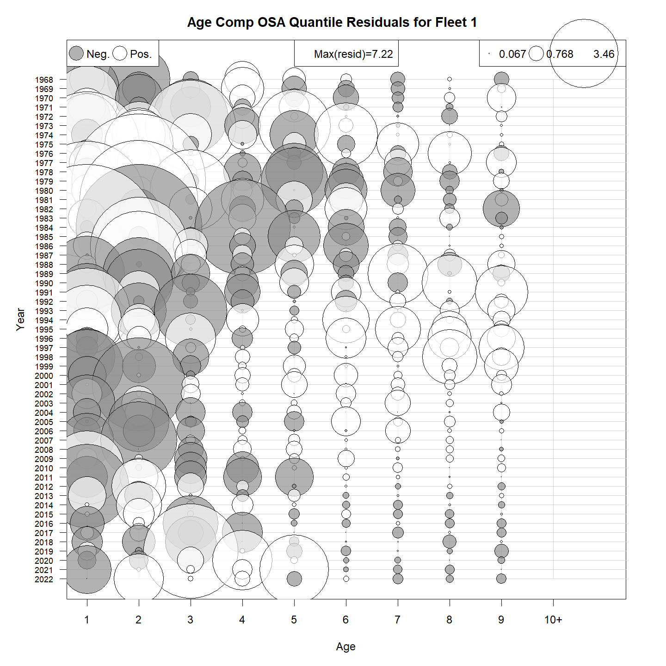
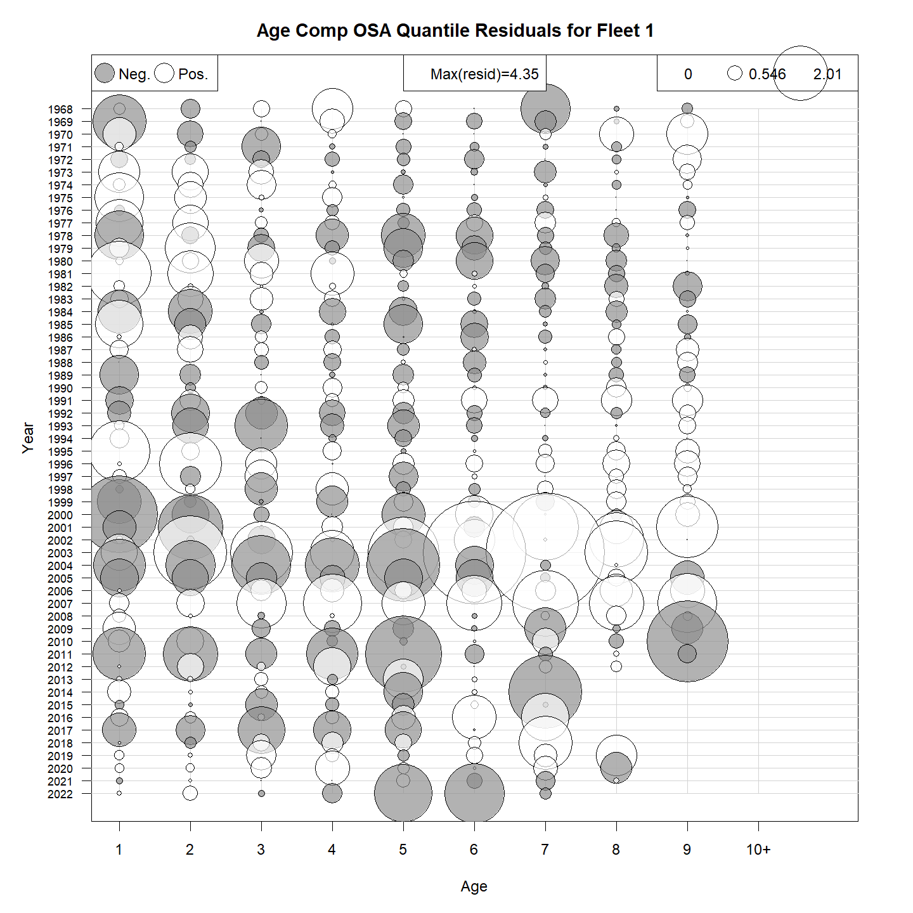
Commercial Catch
Multinomial
Logistic-normal

Slide 5
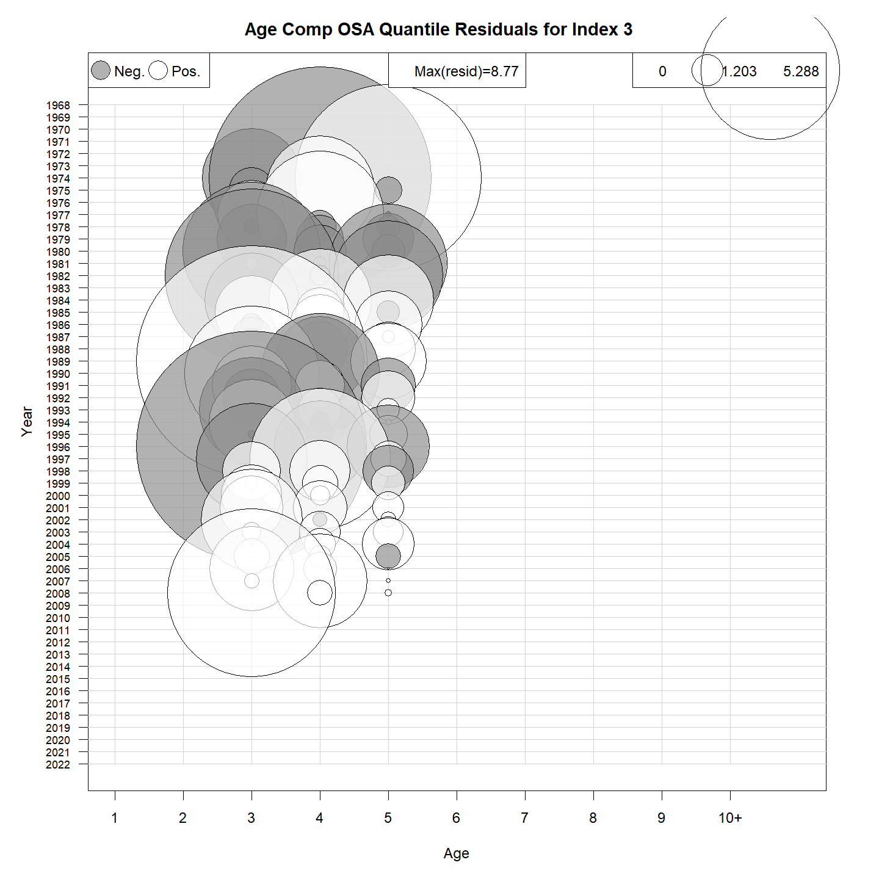
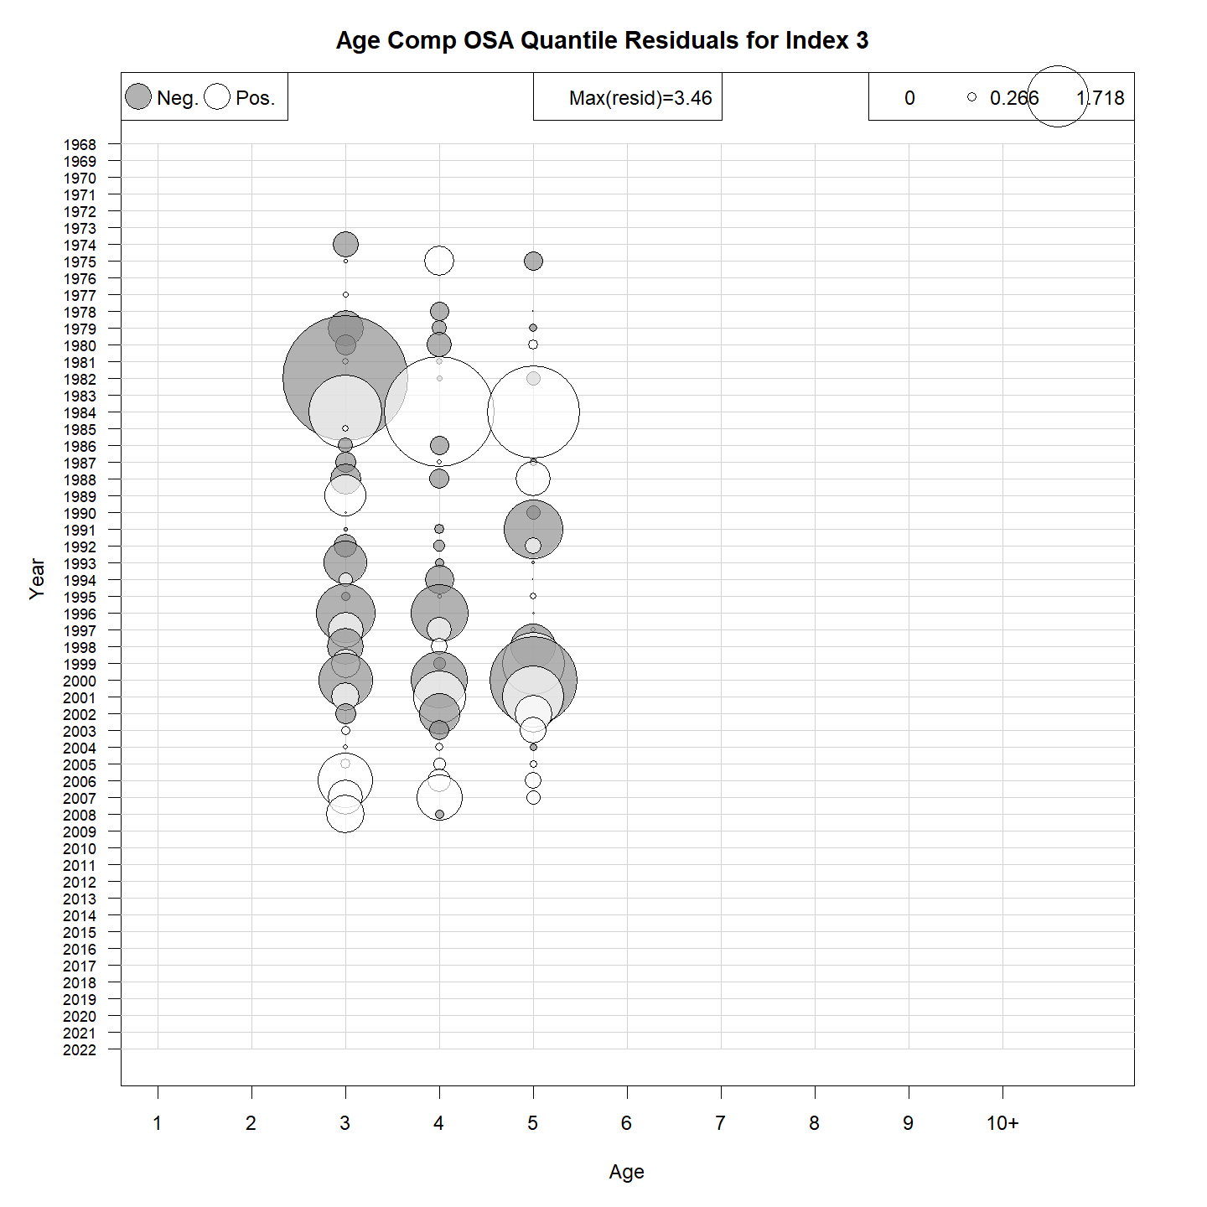
NEFSC Albatross
Multinomial
Logistic-normal

Slide 6
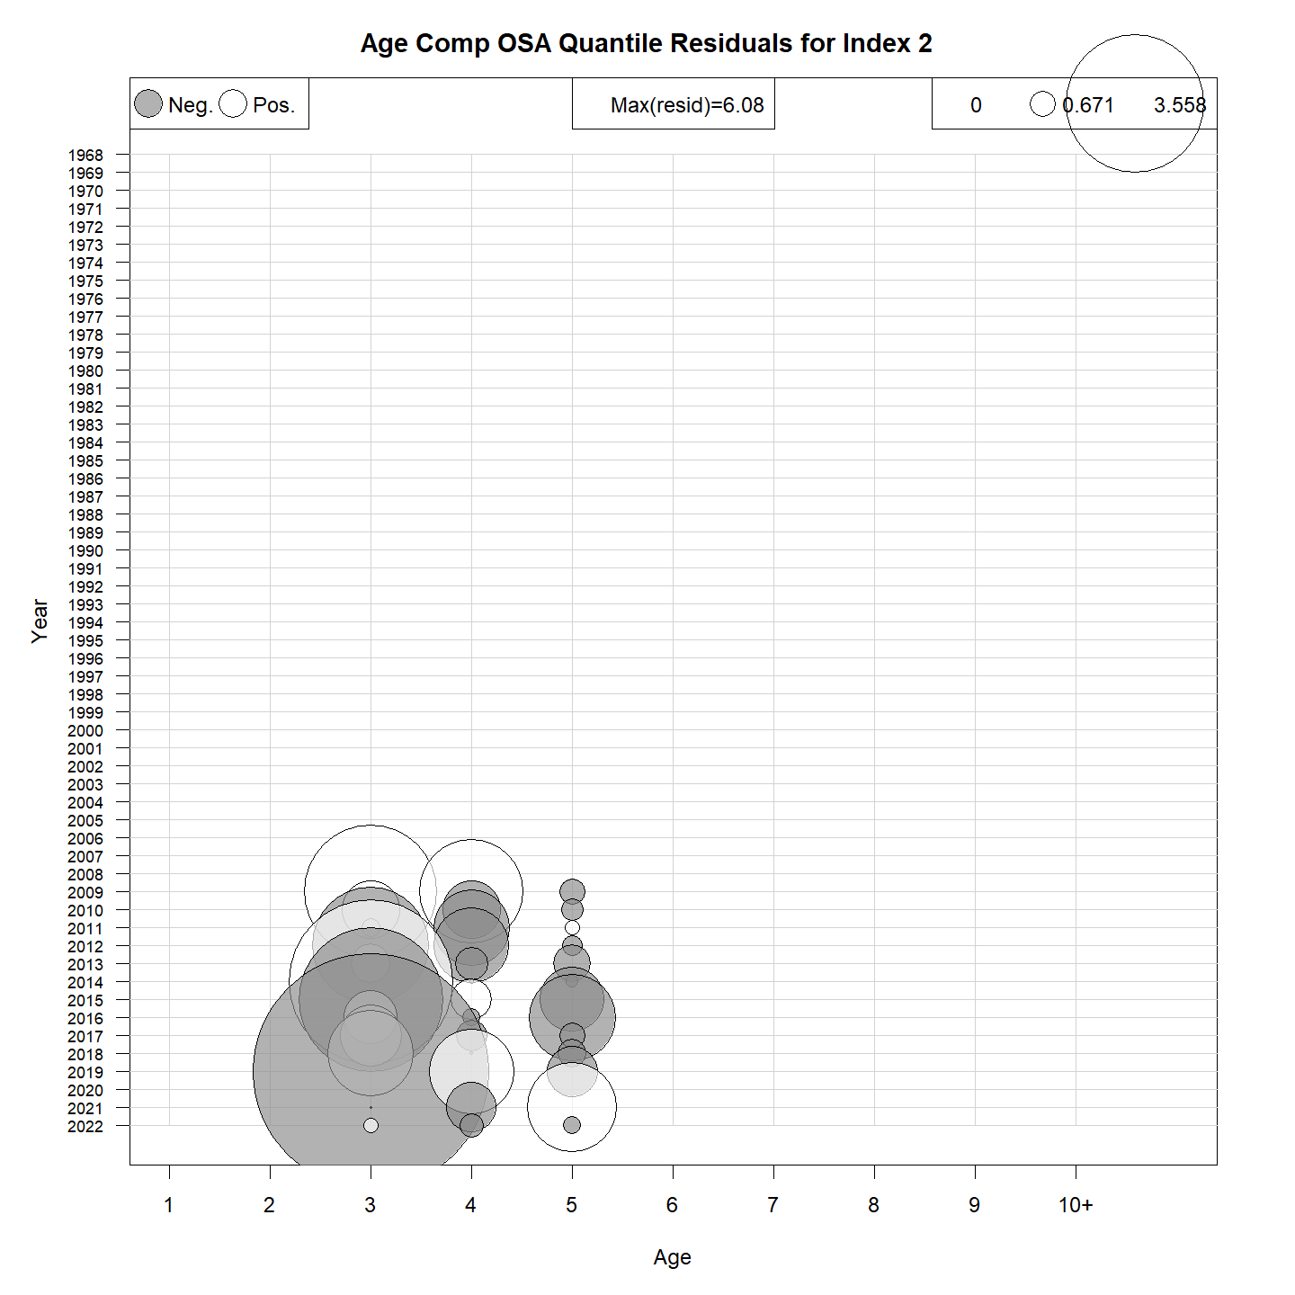
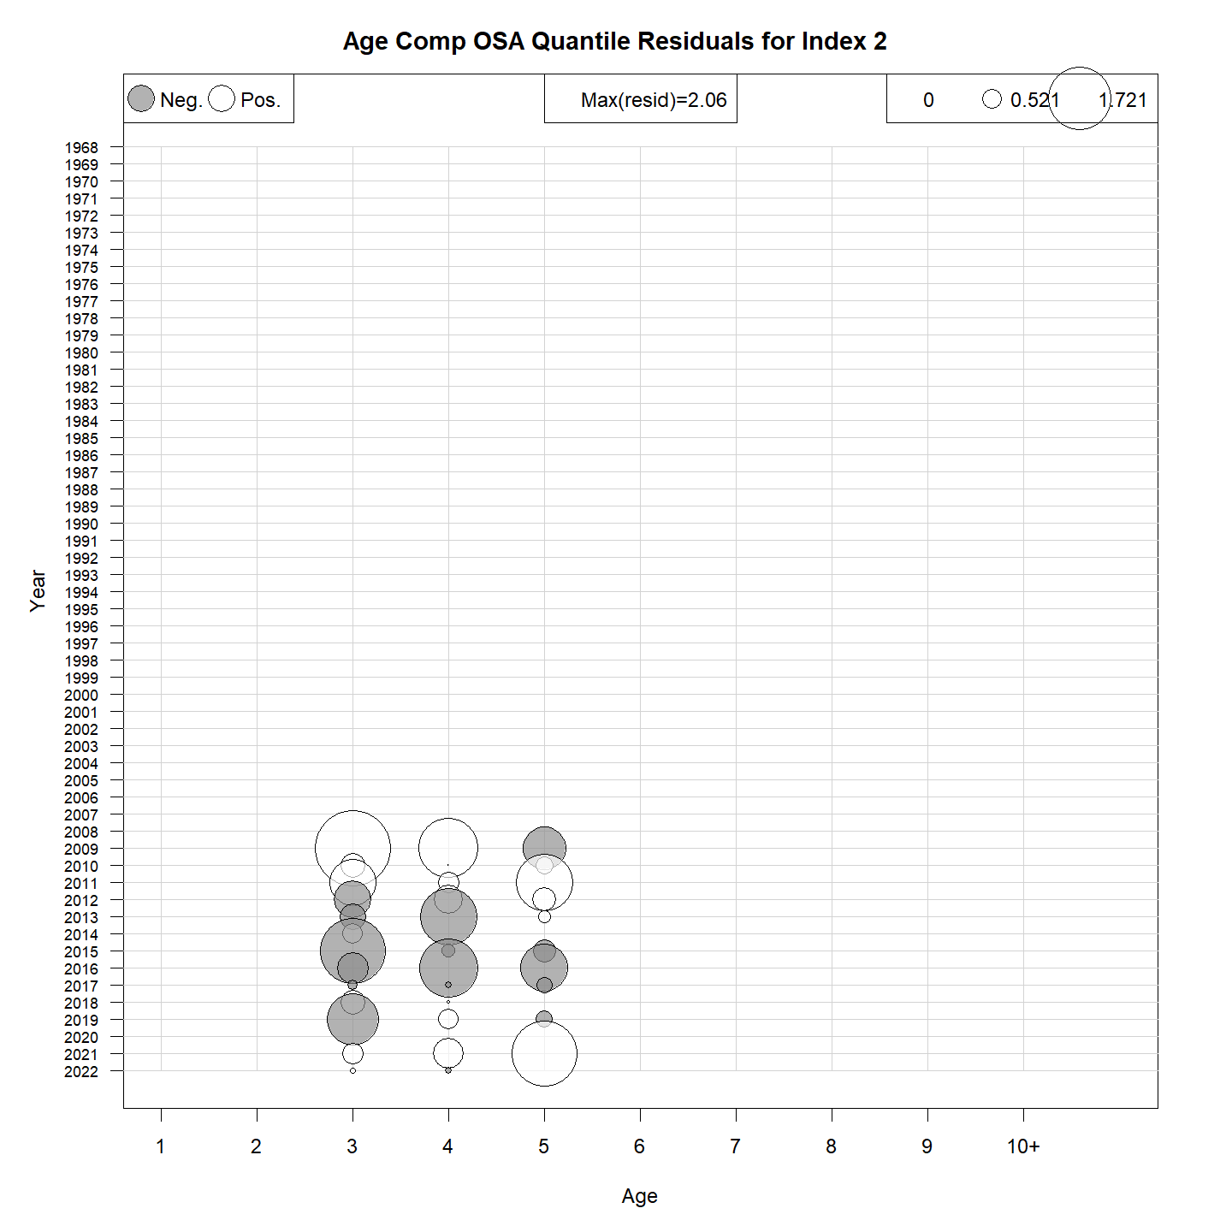
NEFSC Bigelow
Multinomial
Logistic-normal

Slide 7
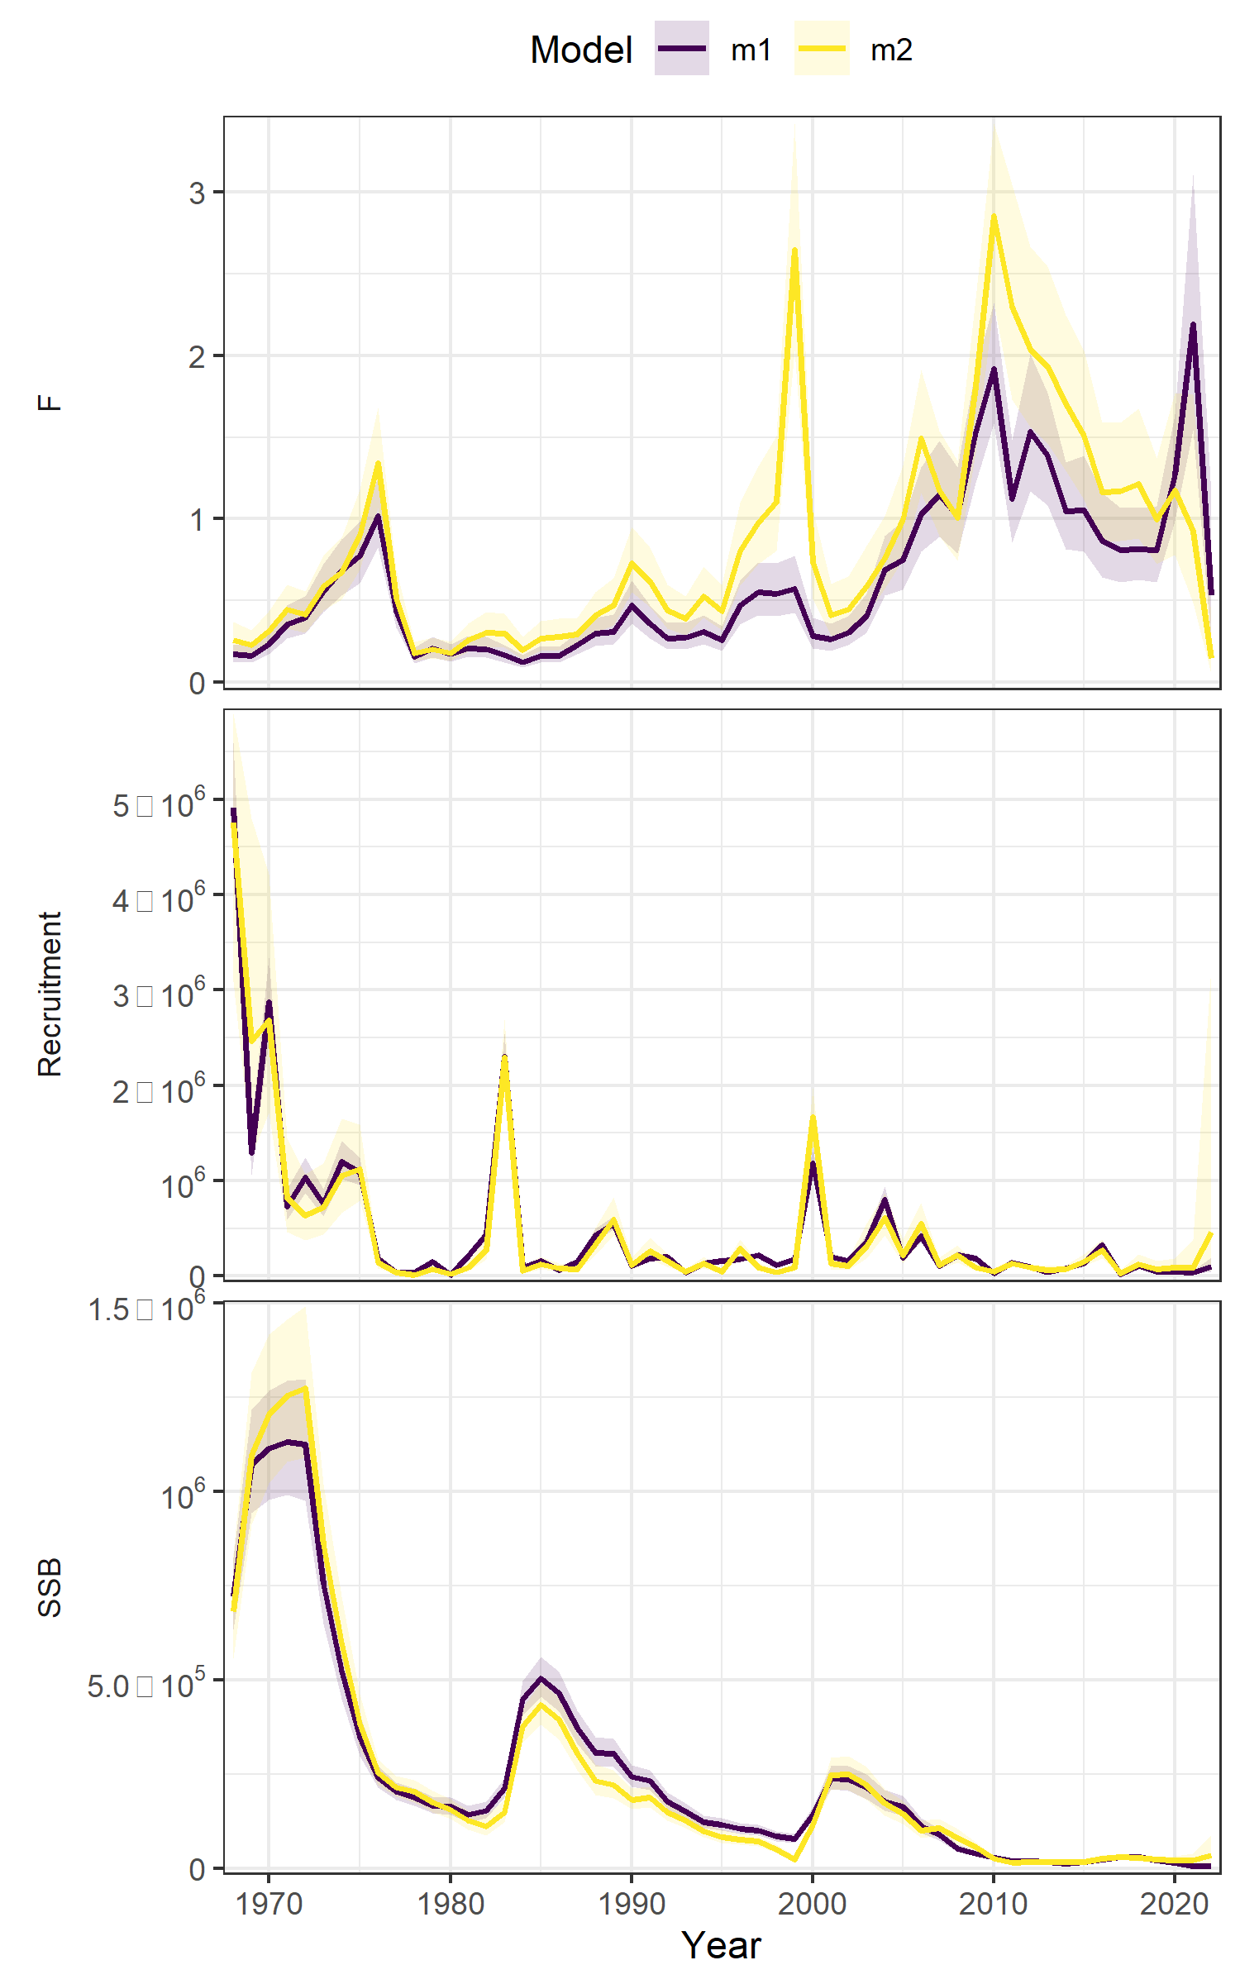
Age Comp Summary
Moved to logistic-normal
Run | age_comp | rho_R | rho_SSB | rho_Fbar
m1 | multinomial | 0.1608 | 0.3633 | -0.228
m2 | logistic-normal-miss0 | 0.7369 | 0.7068 | -0.2969

Slide 8
The plan
ASAP → WHAM
Age-comps
Recruitment
Time varying
Selectivity
NAA

Slide 9
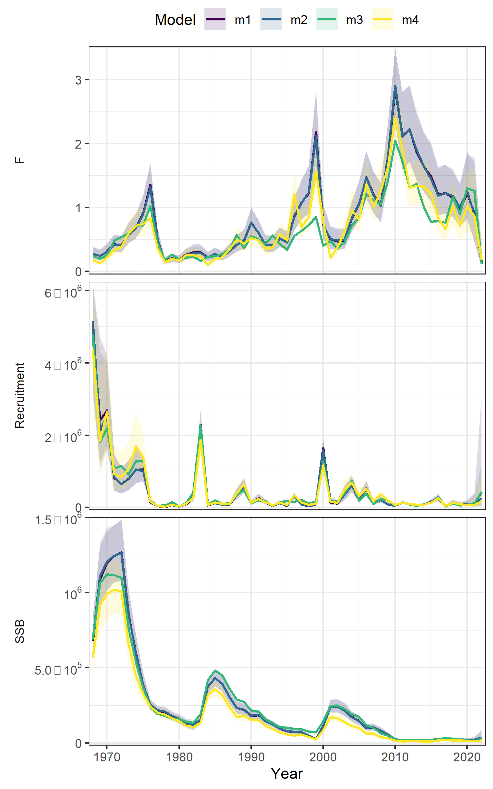
Recruitment
Run | Treatment | dAIC | AIC | rho_R | rho_SSB | rho_Fbar
m3 | mean iid | 0 | -2897.5 | 0.266 | 0.4866 | 7.399
m1 | Random walk | 480.3 | -2417.2 | 0.7459 | 0.772 | -0.3412
m2 | mean ar1_y | 605 | -2292.5 | 0.753 | 0.7551 | -0.3807
m4 | Beverton-holt | 726.1 | -2171.4 | 0.8414 | 0.7692 | -0.3566
Notes:
M3 = m5
M1 = m3
M2 = m4
M4 = m6

Slide 10
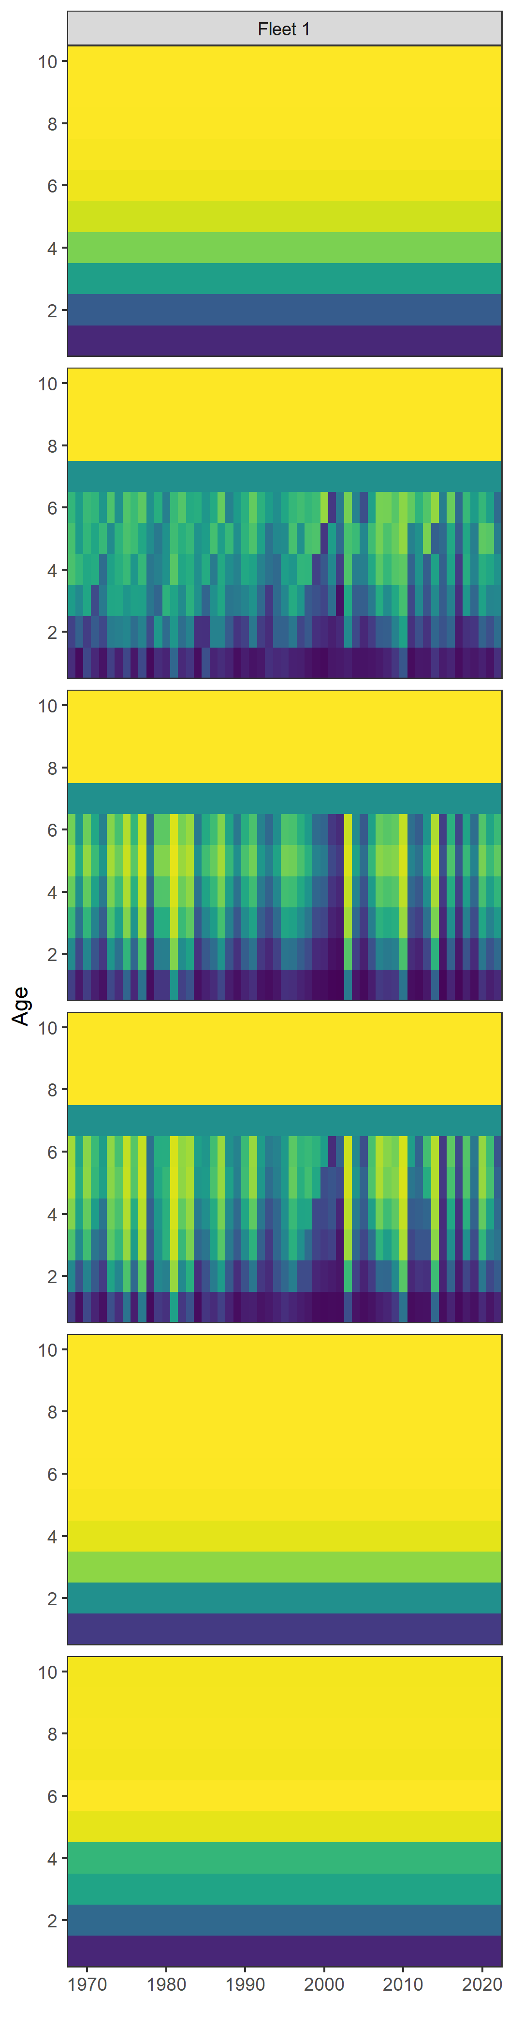

Time varying selectivity
Run | Treatment | dAIC | AIC | rho_R | rho_SSB | rho_Fbar
m4 | 2dar1 | 0 | -2643.5 | 0.1141 | 0.2663 | 5.6593
m3 | ar1_y | 173 | -2470.5 | 0.875 | 0.8472 | -0.5515
m1 | none | 226.3 | -2417.2 | 0.7459 | 0.772 | -0.3412
m6 | ar1_a | 253.3 | -2390.2 | 0.5303 | 0.5566 | -0.2744
m2 | iid_age | 273.3 | -2370.2 | 0.694 | 0.6465 | -0.3042
m5 | iid_log | 6665.7 | 4022.2 | 0.8428 | 1.0805 | -0.51
Notes:
M4 = m10
M3 = m9
M1 = m3
M6 = test
M2 = m8
M5 = m11

Slide 11
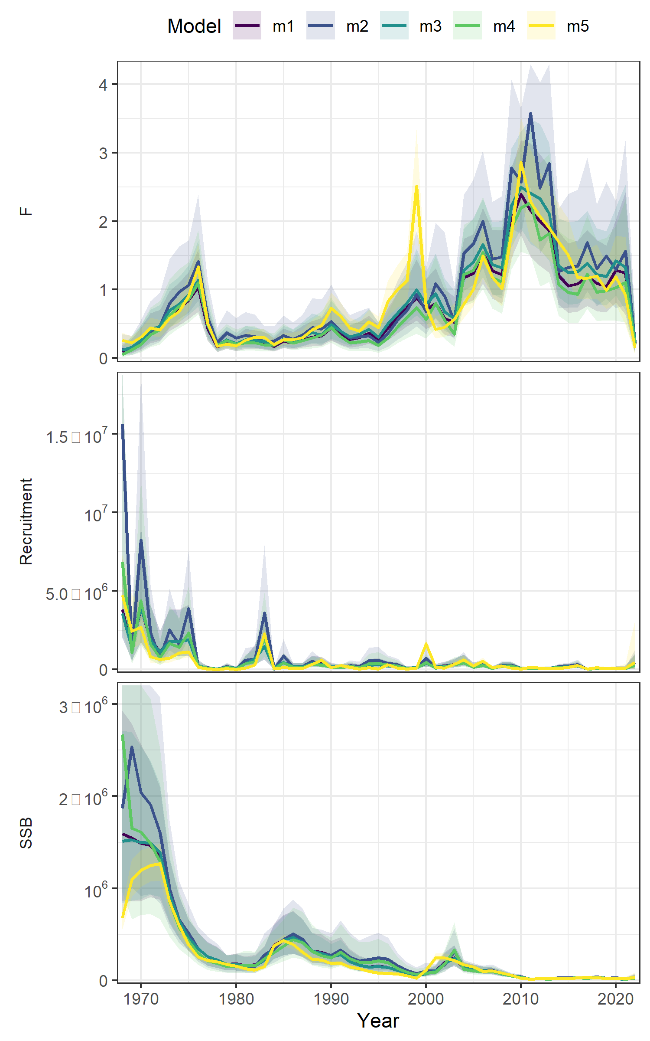
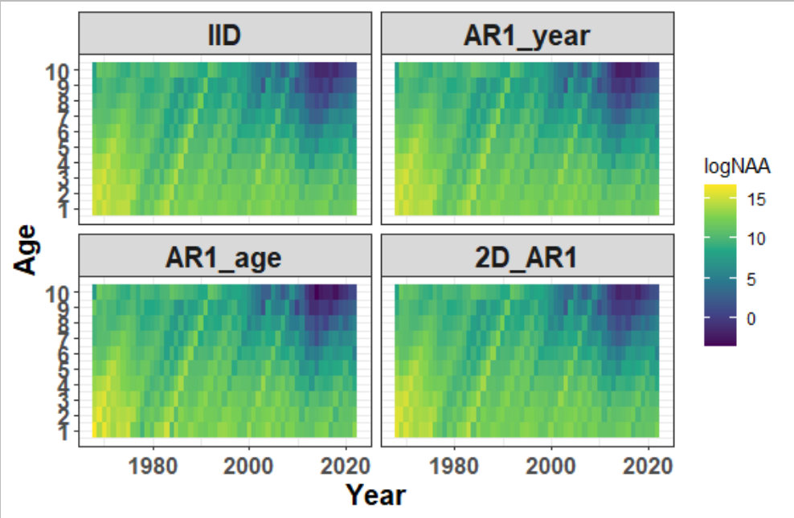
State-space
Run | Treatment | dAIC | AIC | rho_R | rho_SSB | rho_Fbar
m2 | ar1_a | 0 | -2563.9 | -0.0074 | 0.1068 | 0.3428
m4 | 2dar1 | 120.9 | -2443 | -0.0694 | 0.1789 | -0.0552
m3 | ar1_y | 134.2 | -2429.7 | -0.124 | 0.0887 | 0.285
m1 | iid | 148.9 | -2415 | -0.1178 | 0.0979 | 0.2782
m5 | ar1_sel | 173.7 | -2390.2 | 0.5303 | 0.5566 | -0.2744
Notes:
M2 = m38
M4 = m40
M3 = m39
M1 = m37
M5 = test

Slide 12
Selected run
Logistic normal – miss 0
Ar1_a selectivity for commercial fleet
2dar1_1 on NAA

Slide 13
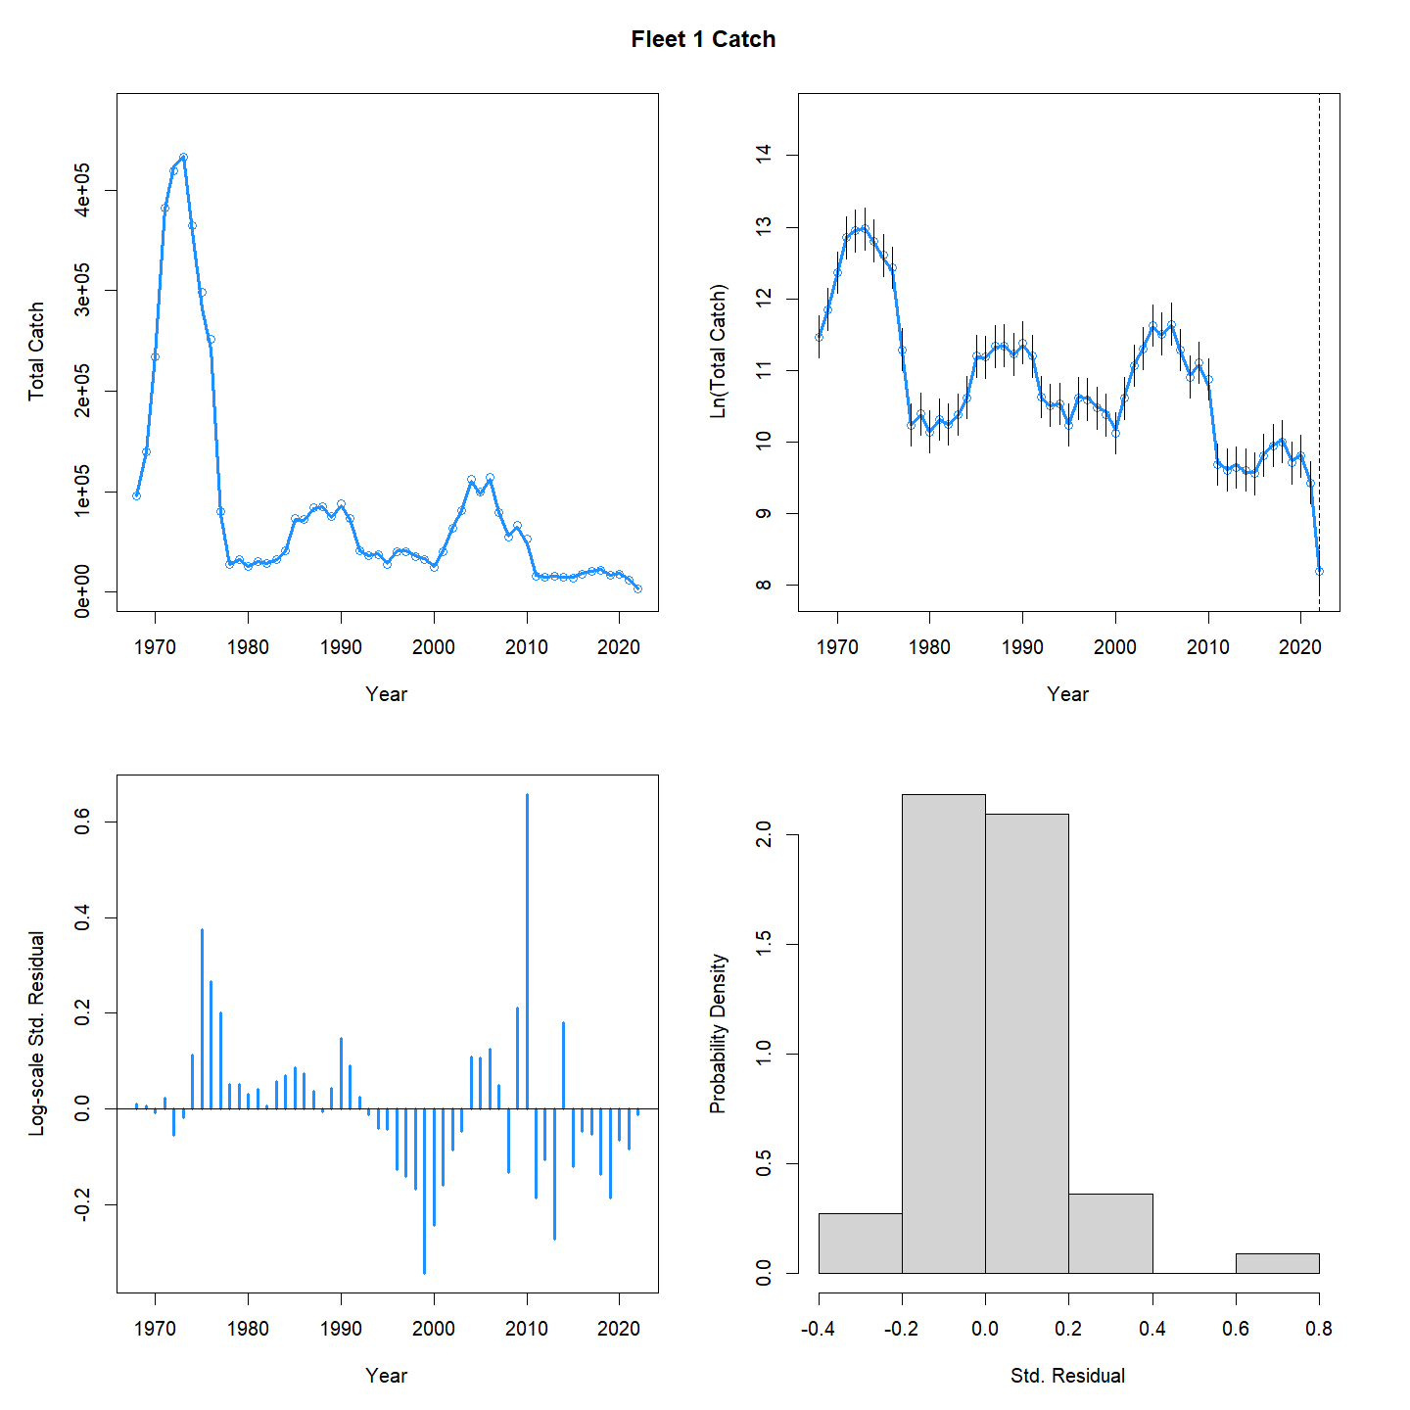
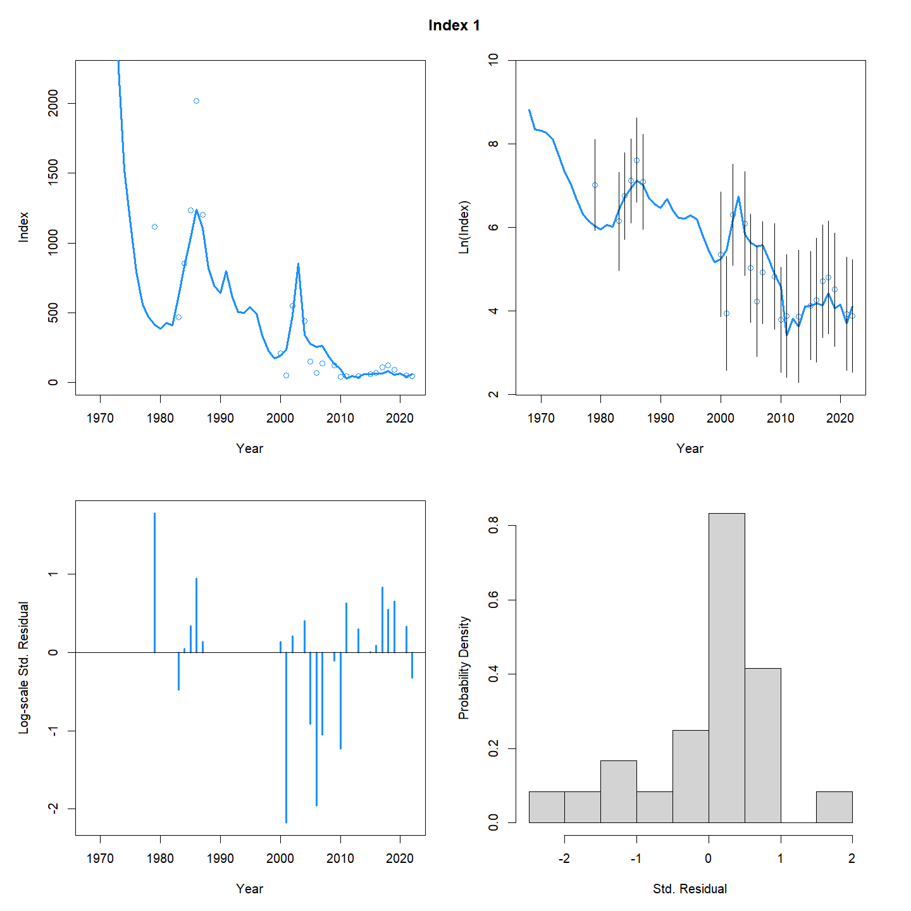
Aggregated fits
Commercial catch
Larval survey

Slide 14
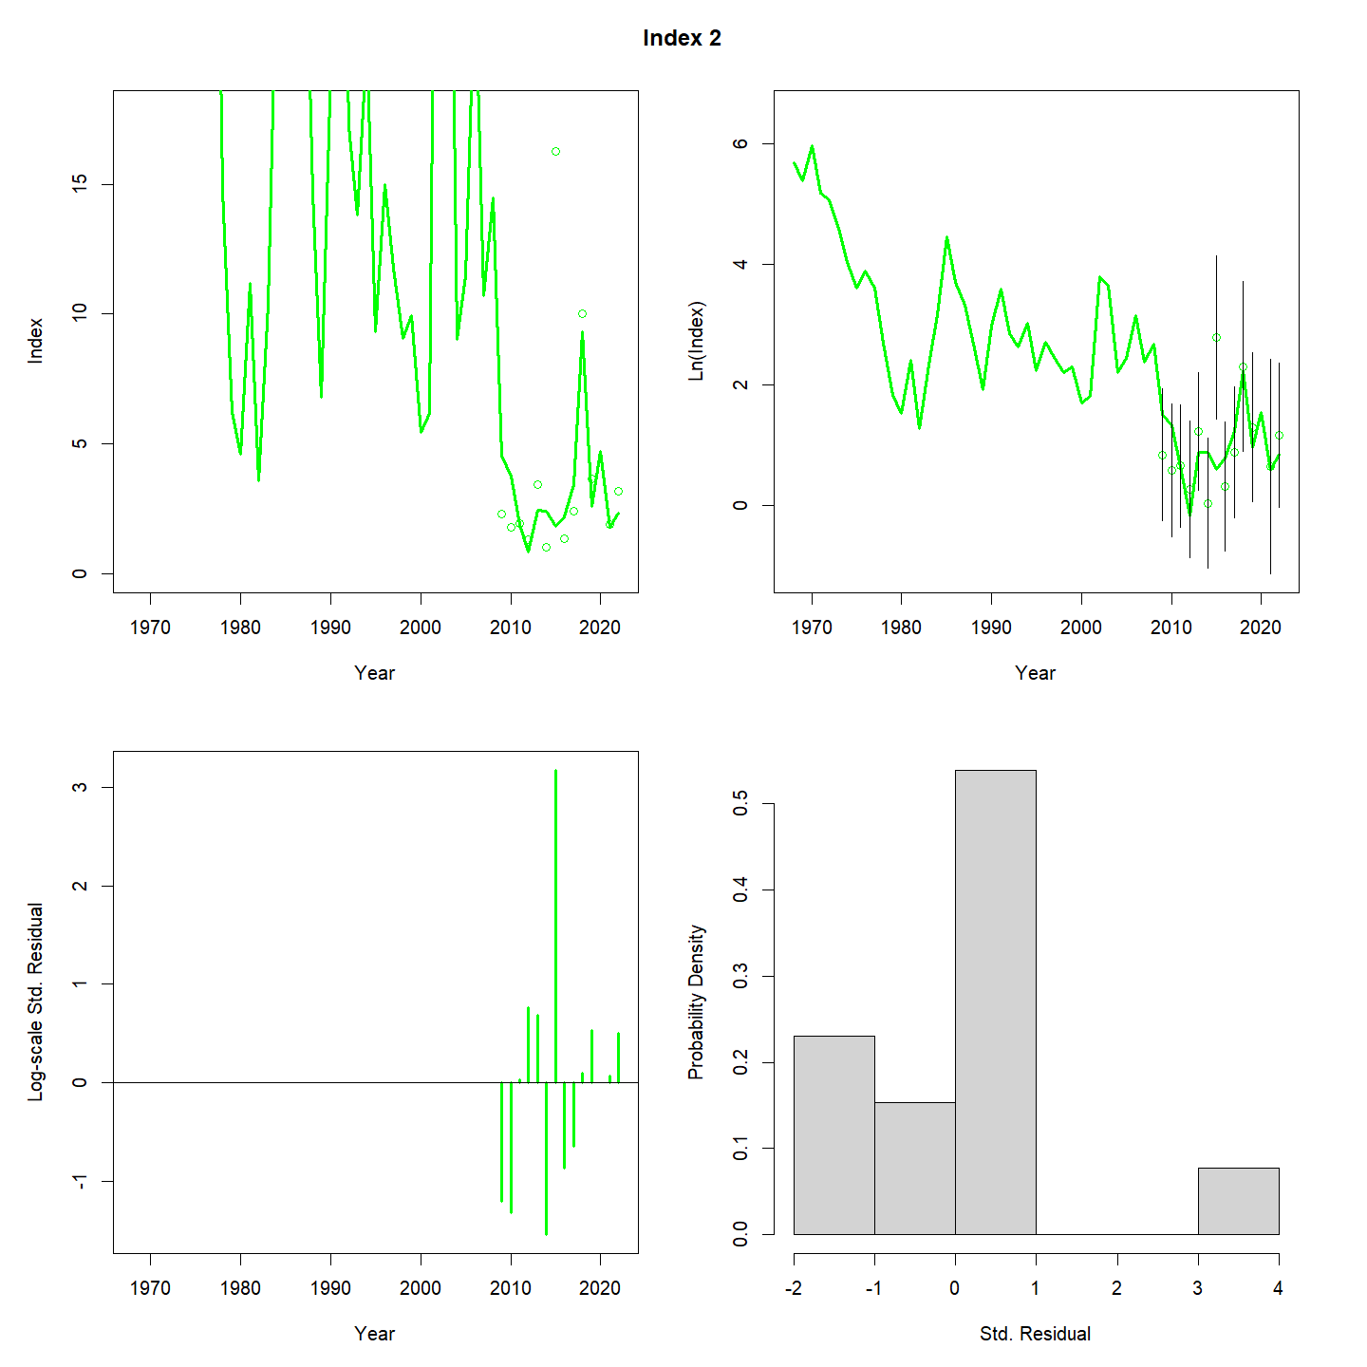
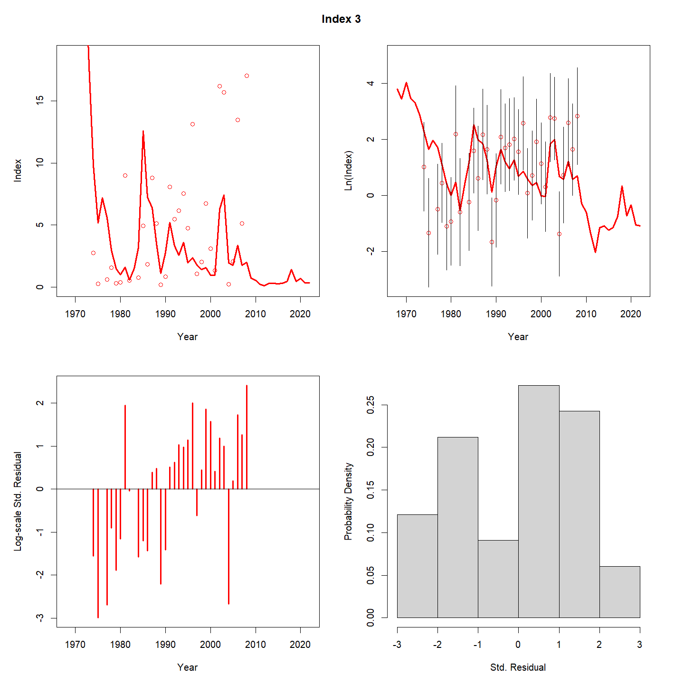
Aggregated fits
Bigelow
Albatross

Slide 15
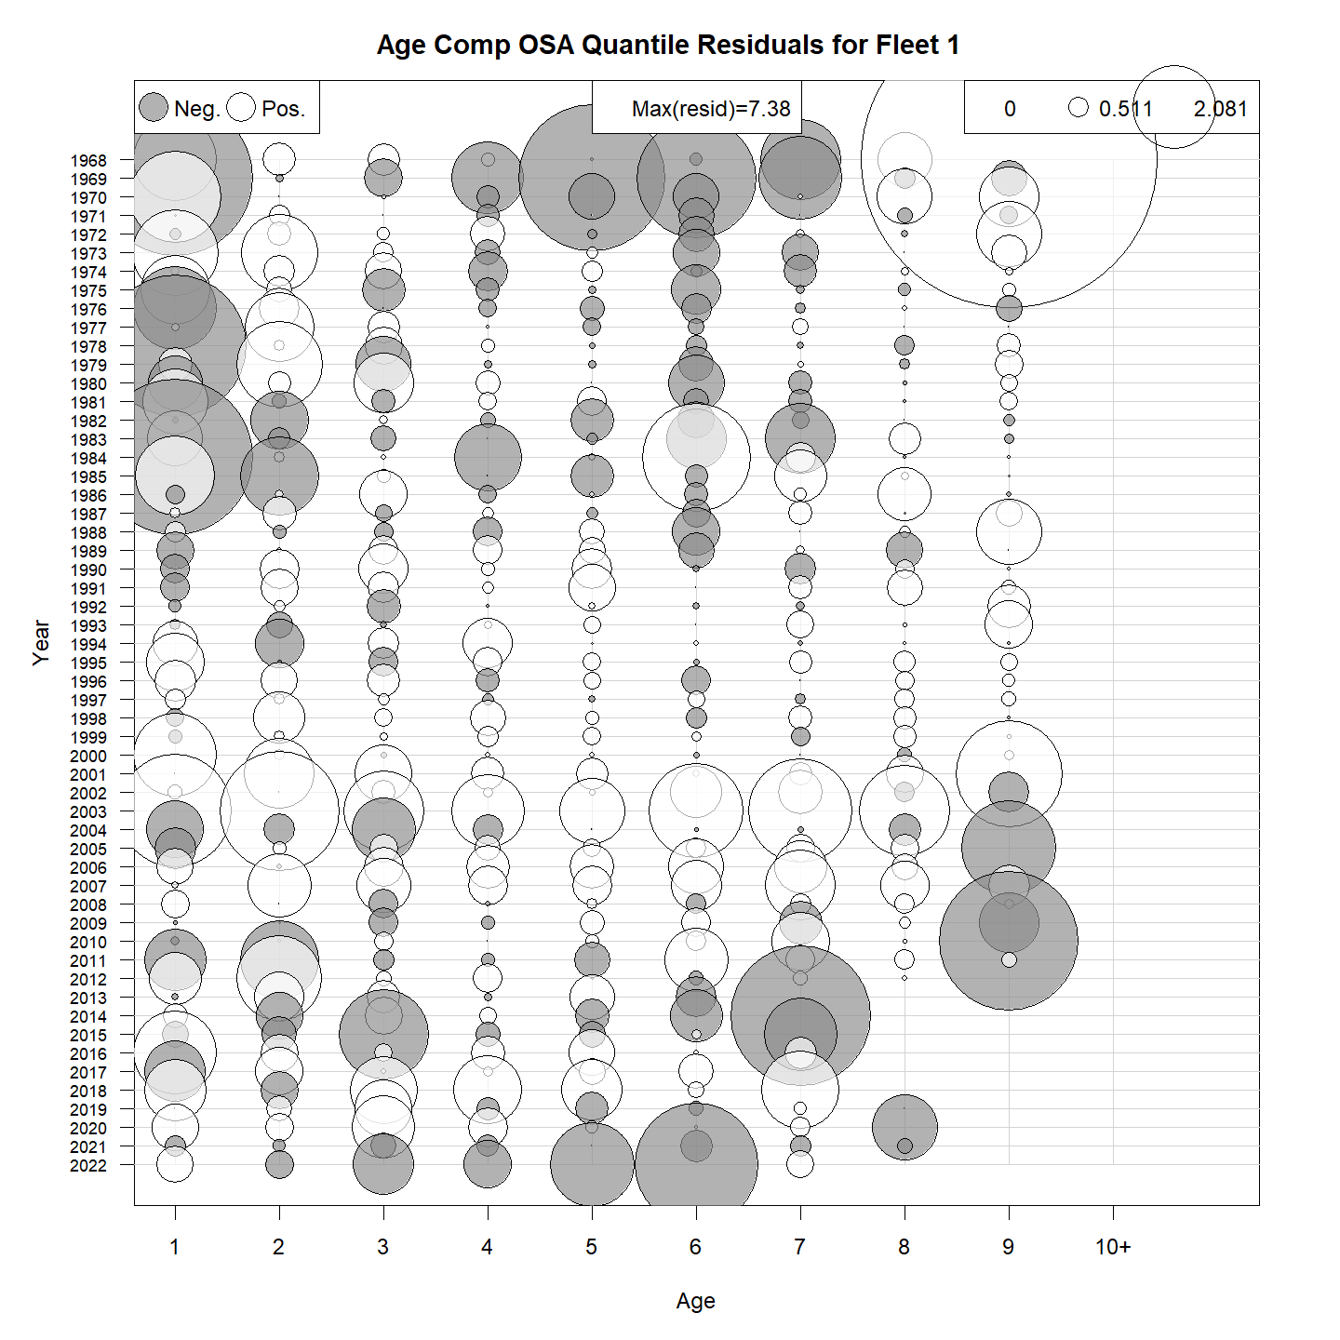
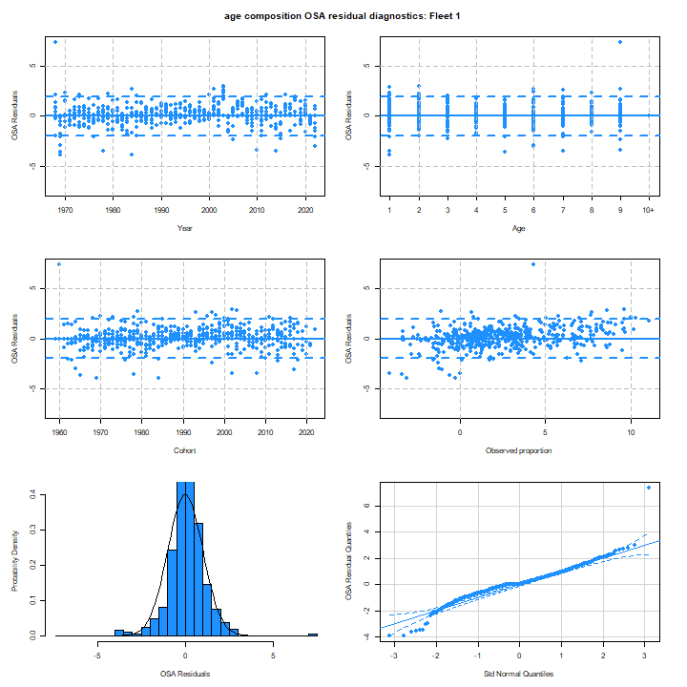
OSA age comps

Slide 16

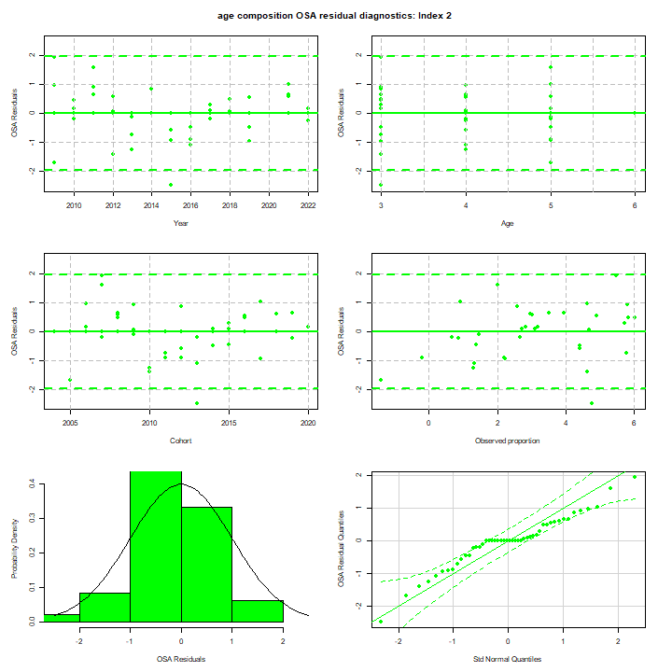
OSA age comps

Slide 17
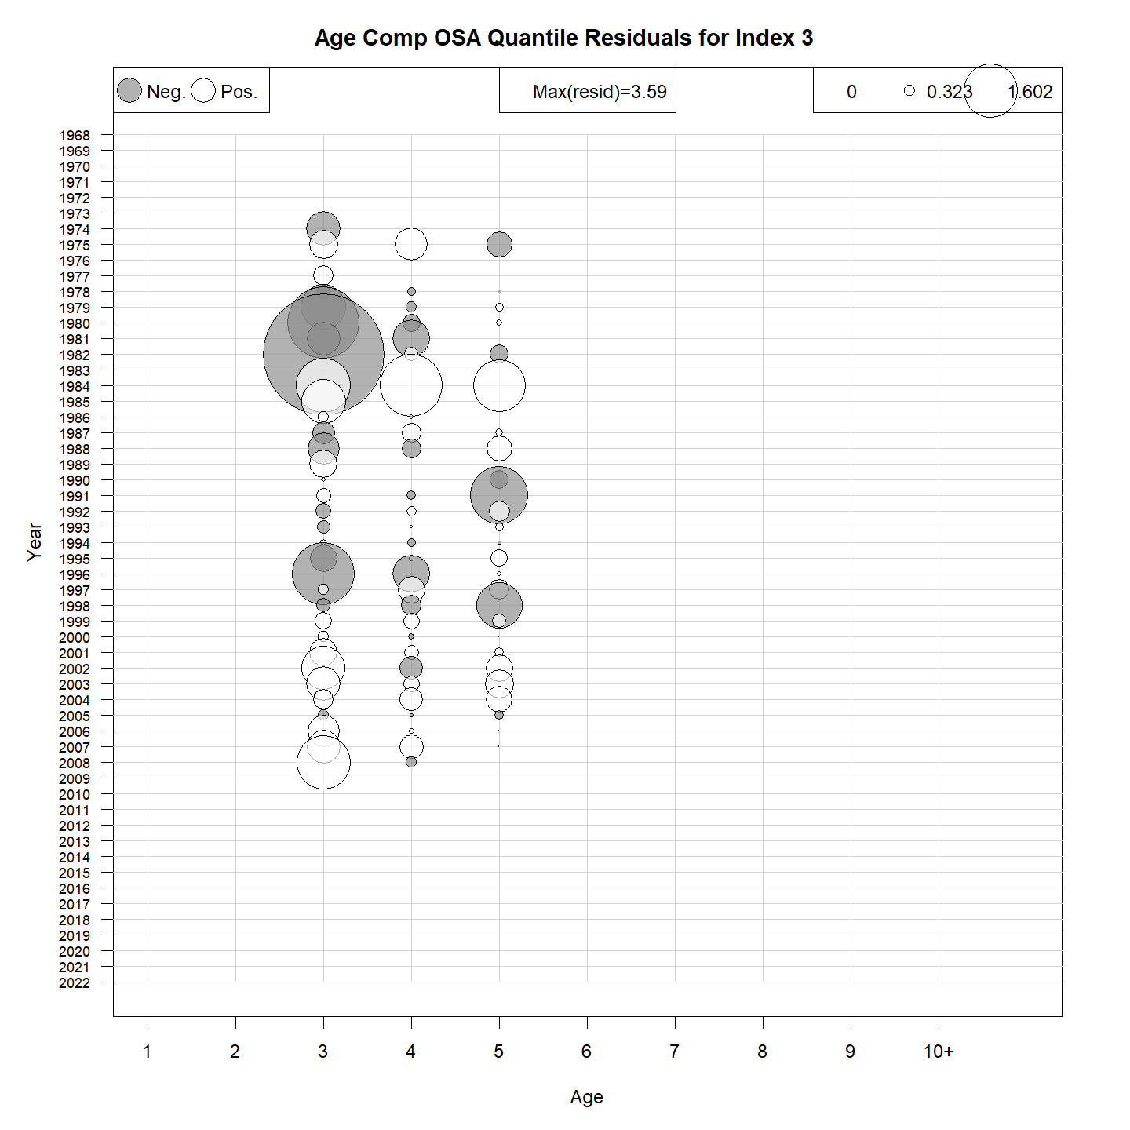
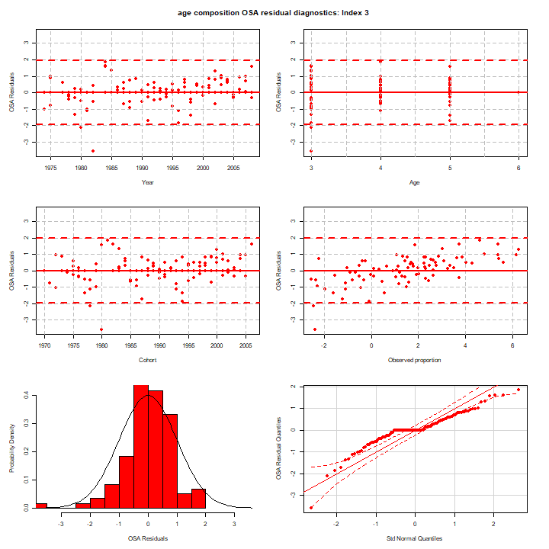
OSA age comps

Slide 18
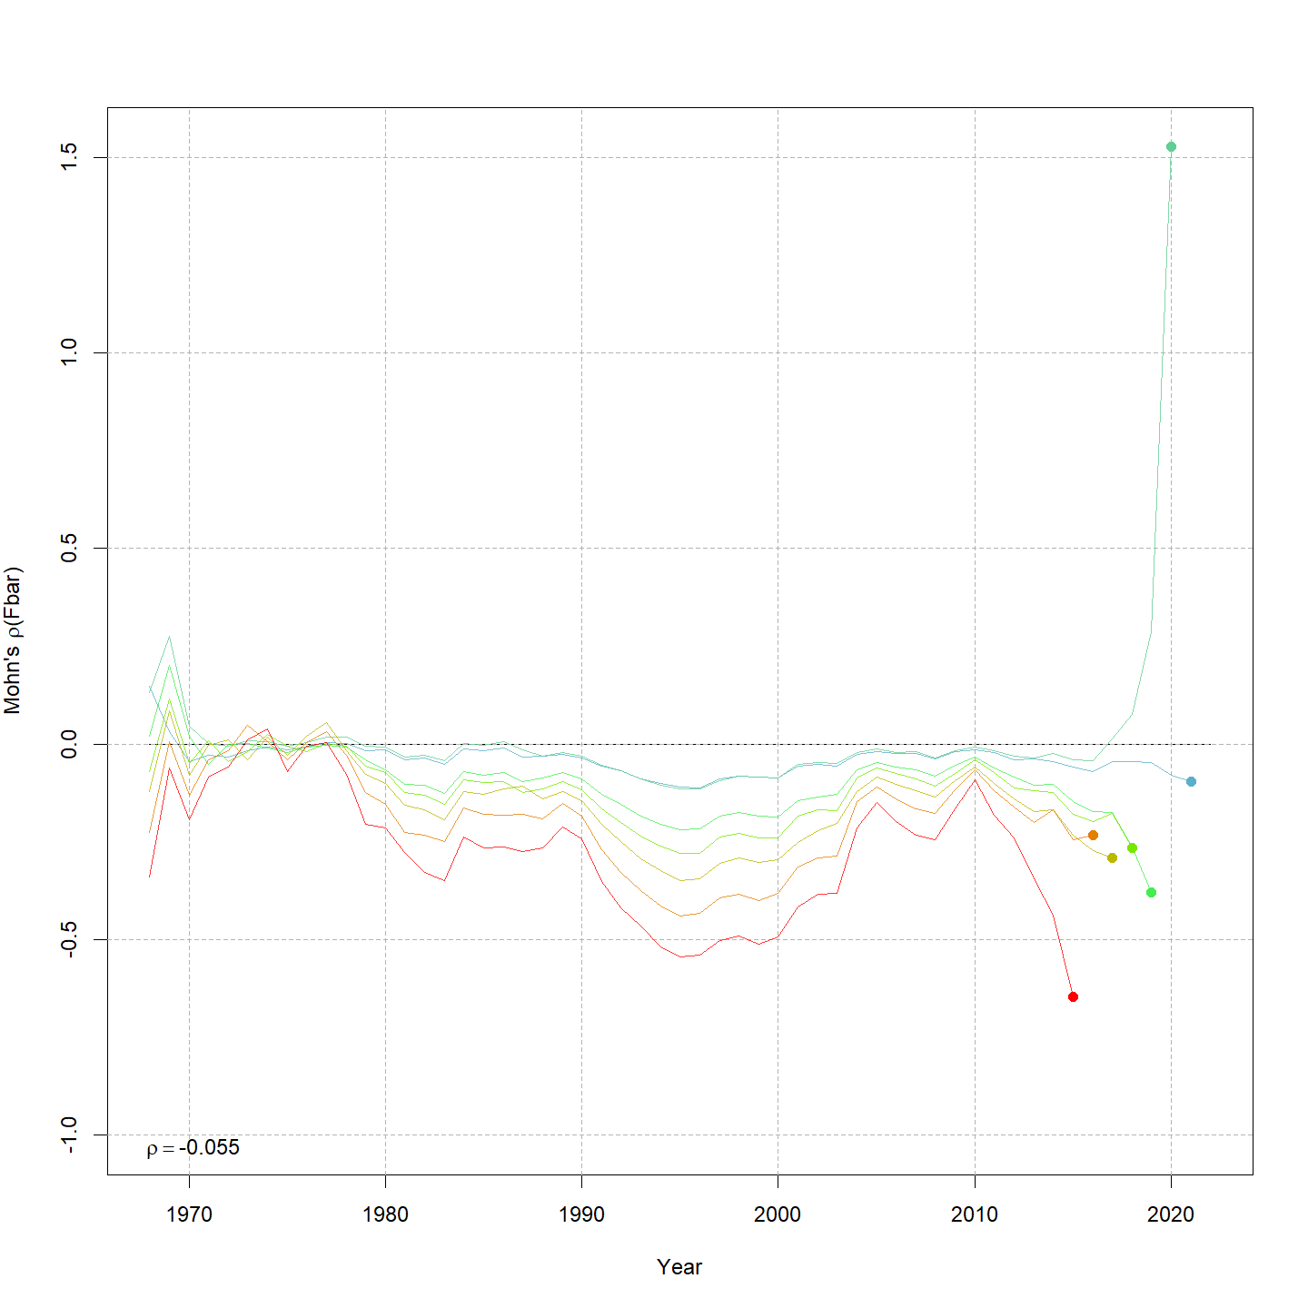
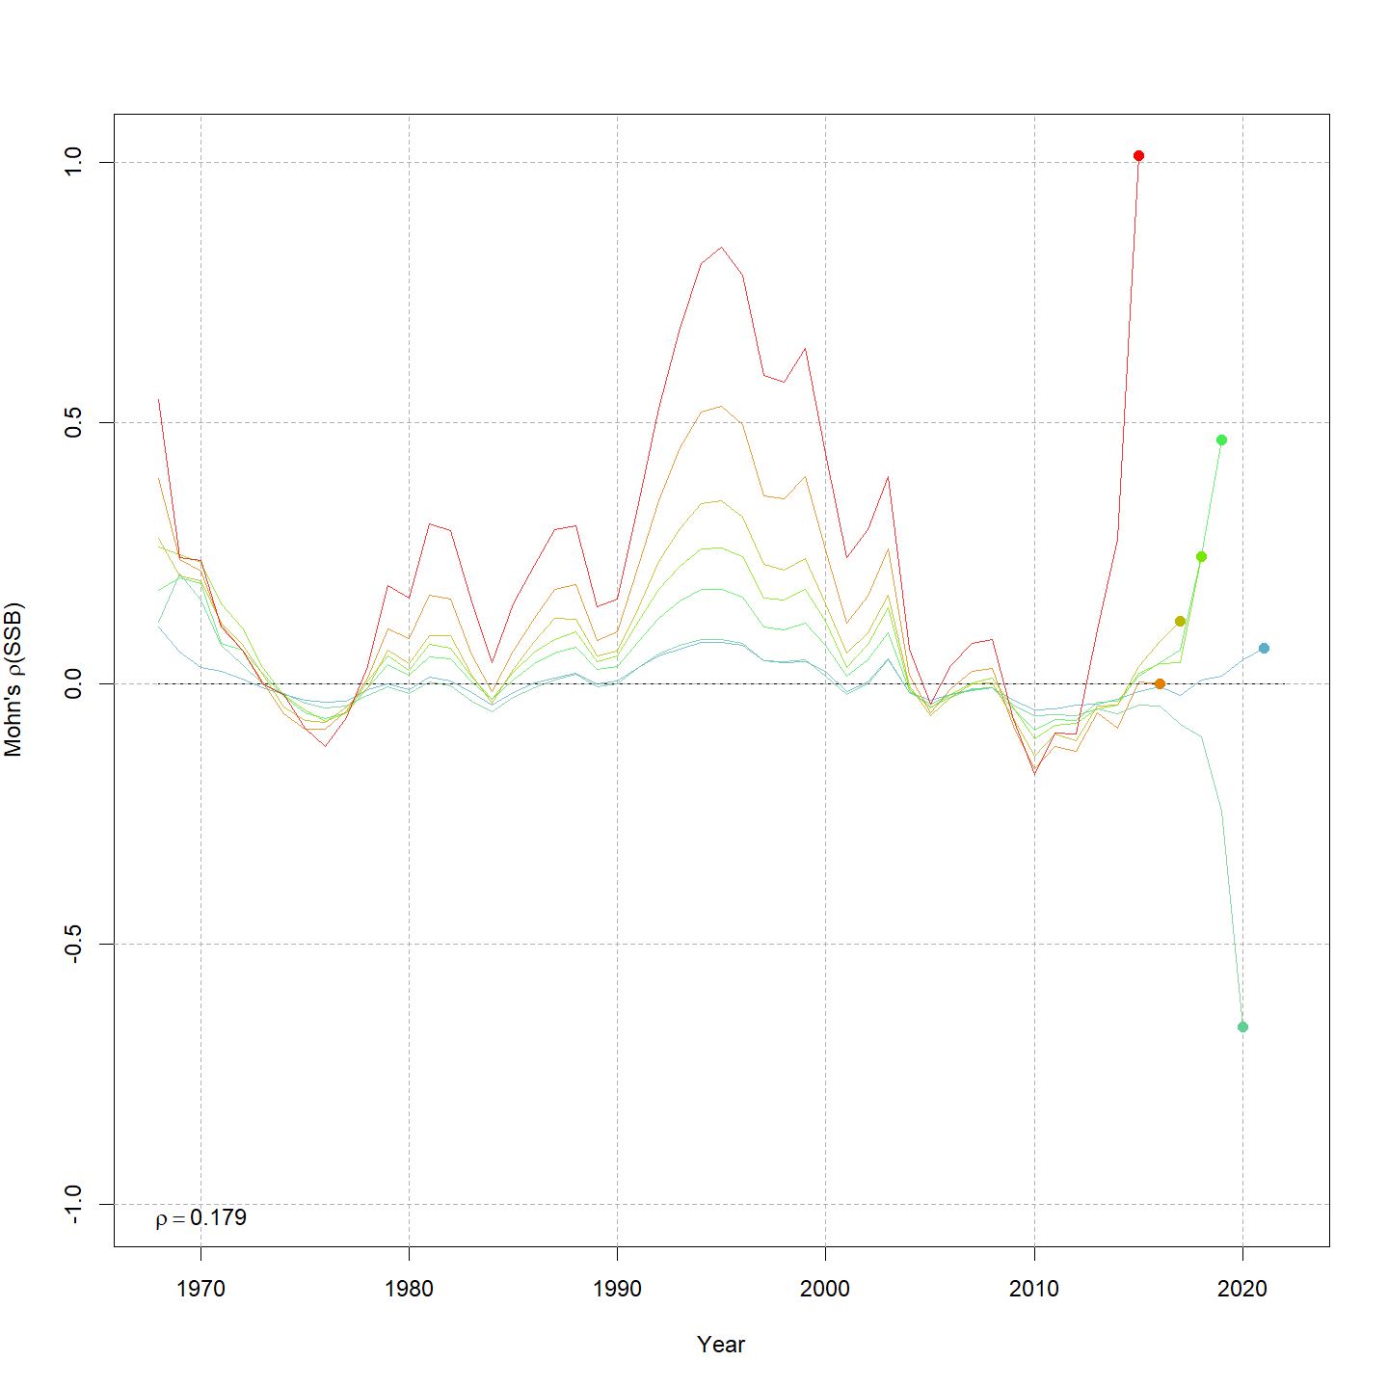
Retro

Slide 19
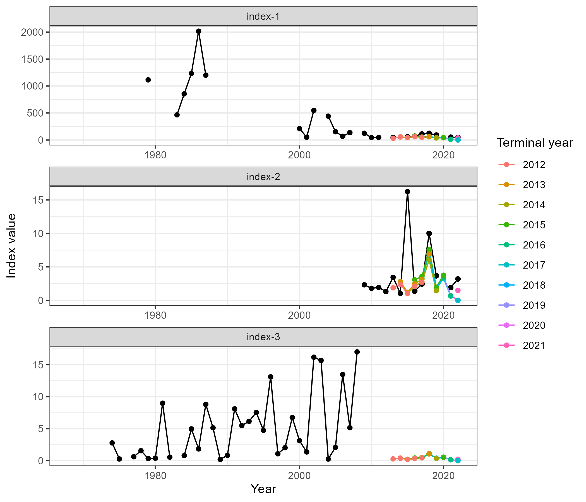
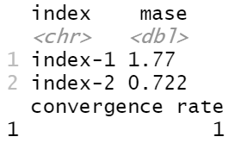
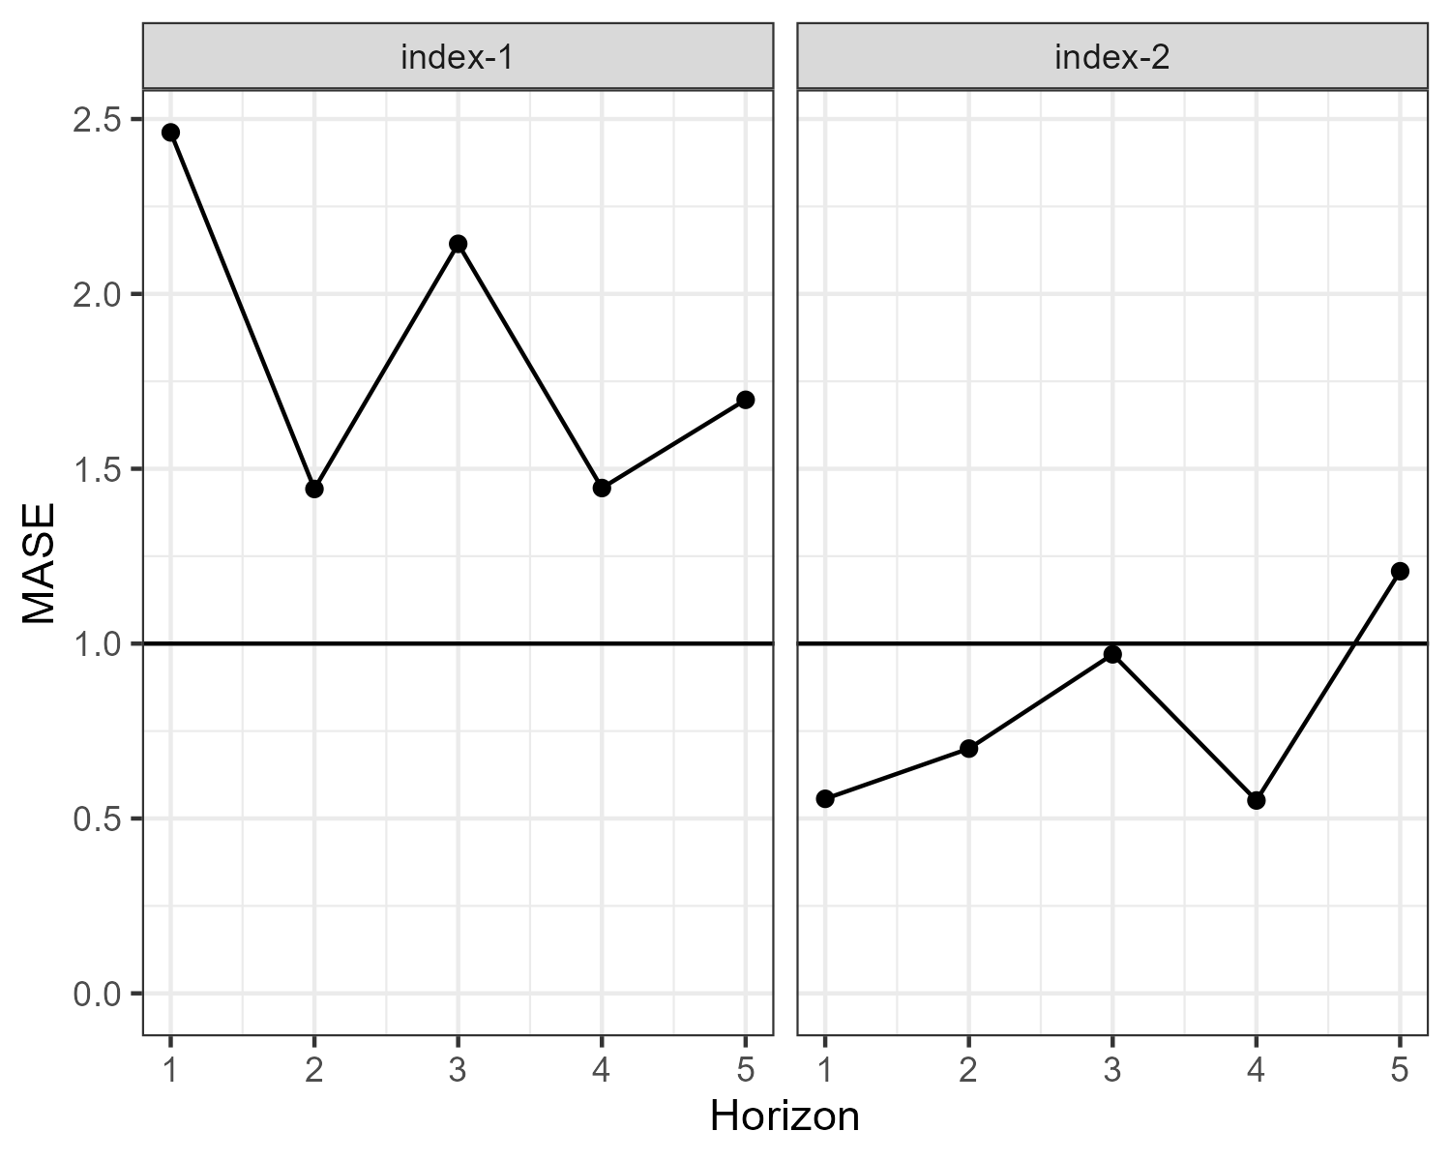
MASE

Slide 20
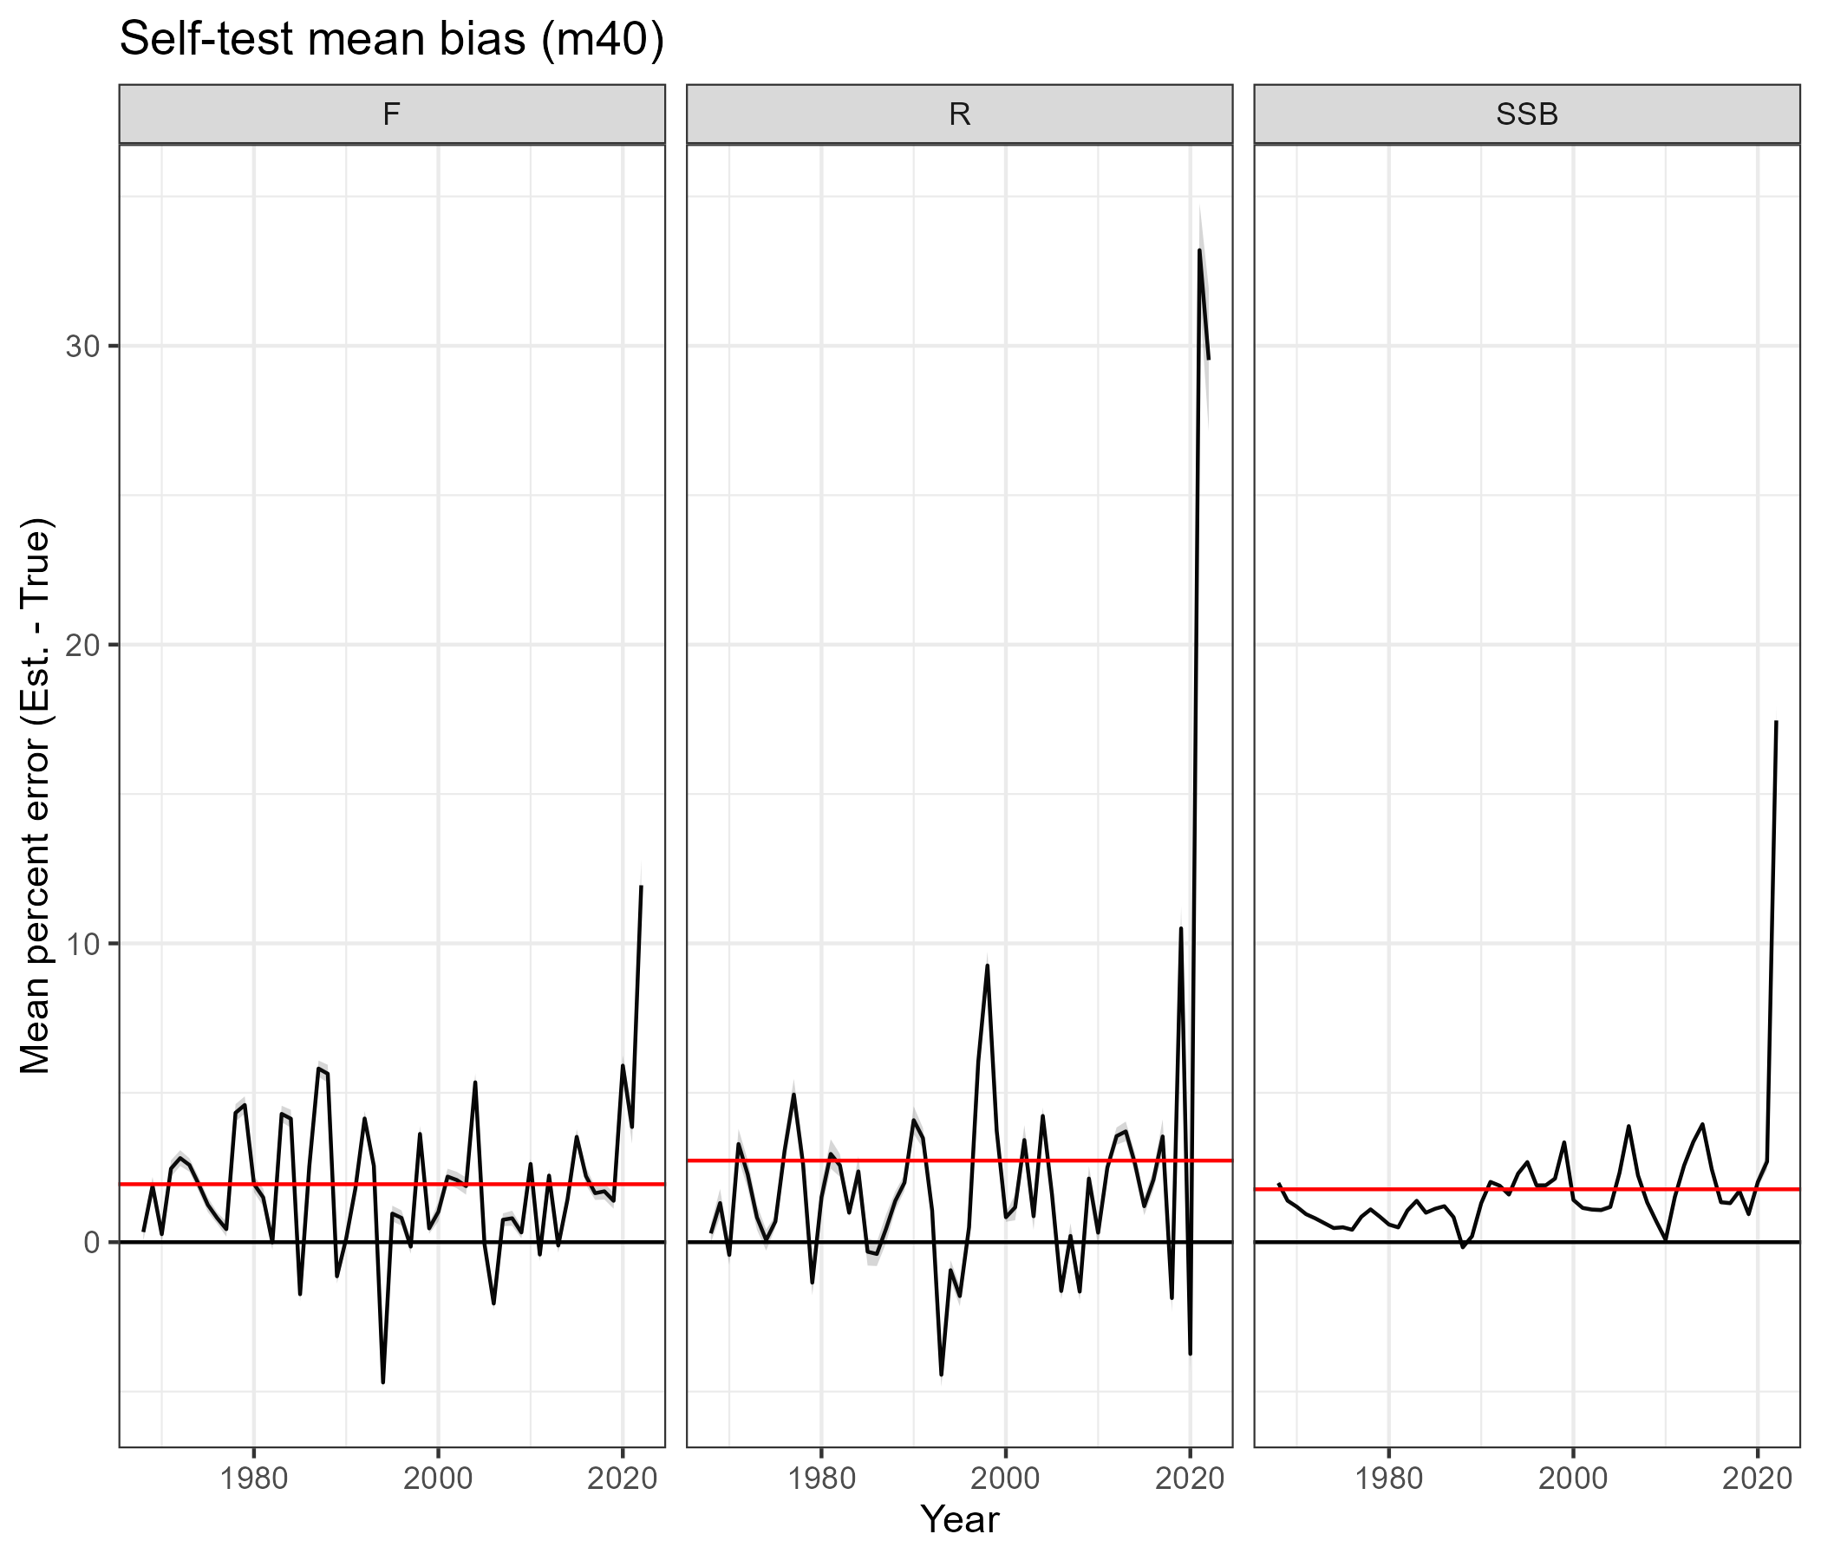
Self-test
VAR | Mean Percent Bias
F | 1.94
R | 2.73
SSB | 1.77

